Slide 1
Ansible and Ansible Tower
Jim Garrett
Senior Solution Architect
jgarrett@redhat.com
May 2018

Slide 2
What You Will Learn
Ansible is capable of handling many powerful automation tasks with the flexibility to adapt to many environments and workflows. With Ansible, users can very quickly get up and running to do real work.
What is Ansible and The Ansible Way
Installing Ansible
How Ansible Works and its Key Components
Ad-Hoc Commands
Playbook Basics
Reuse and Redistribution of Ansible Content with Roles

Slide 3
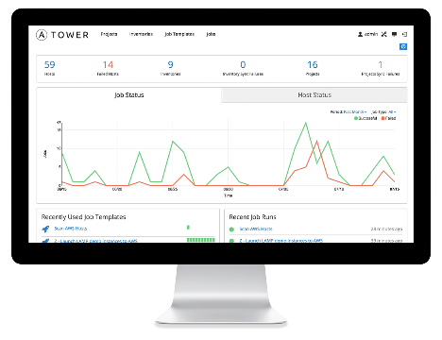
WHAT IS ANSIBLE?
It’s an automation engine - Ansible
Automate What????

Slide 4
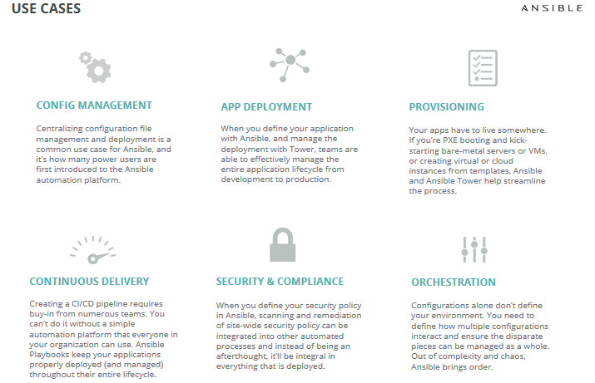

Slide 5
WHAT IS ANSIBLE?
It’s an automation engine - Ansible
It’s an automation language - Ansible Playbooks.
Enterprise framework for controlling, securing and managing your automation – Ansible Tower

Slide 6
SIMPLE
POWERFUL
Agentless
Human readable automation
No special coding skills needed
Tasks executed in order
Get productive quickly
Configuration management
App deployment
Workflow orchestration
Orchestrate the app lifecycle
Agentless architecture
Uses OpenSSH & WinRM
More efficient & more secure

Slide 7
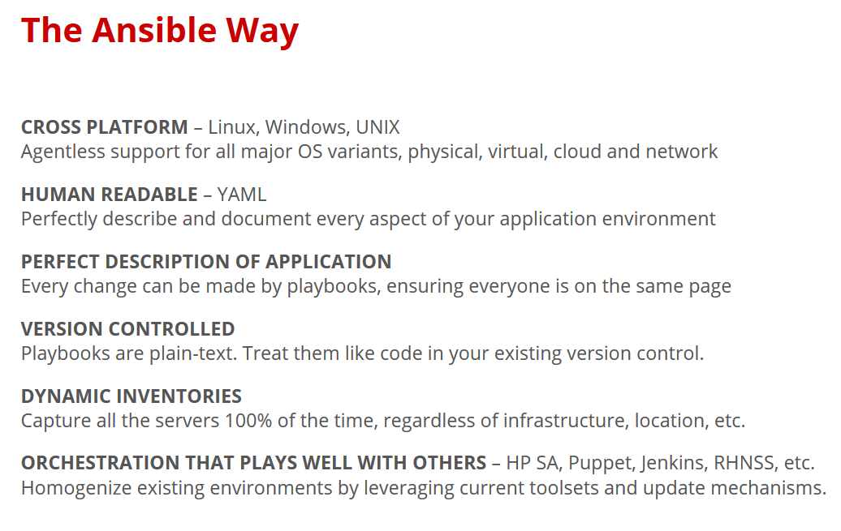

Slide 8
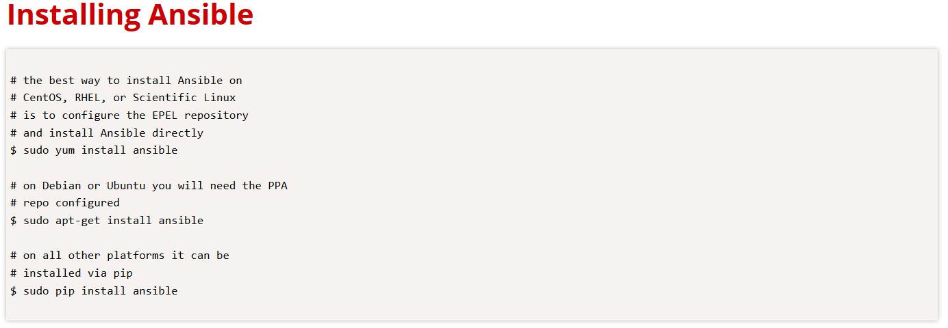

Slide 9
Lab 1 : Ansible_Install

Slide 10
Lab Location
https://www.mikehalkovitch.net/ansible-workshop

Slide 11
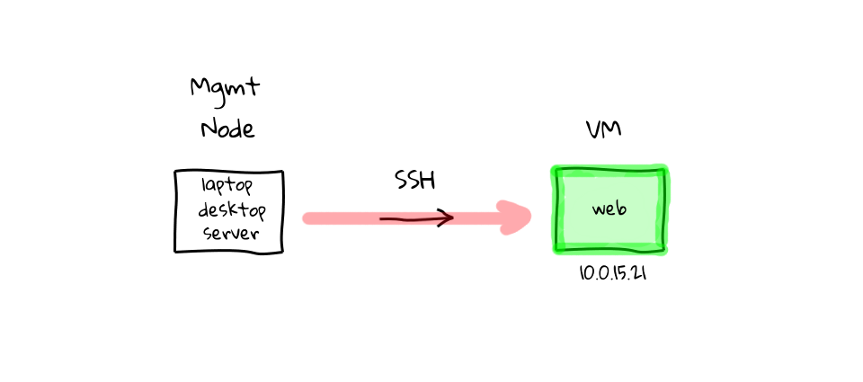
How ANSIBLE Works – Simplicity – Command Line

Slide 12
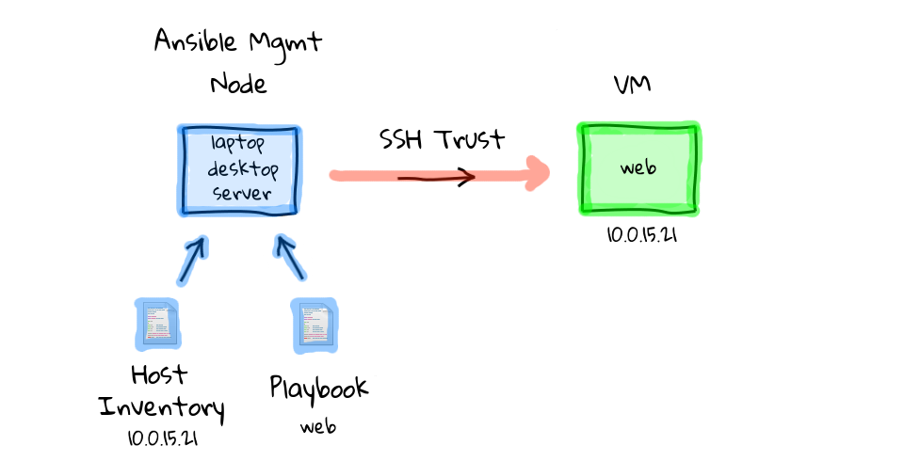
How ANSIBLE Works – Simplicity - playbook

Slide 13
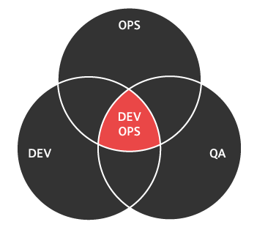
How ANSIBLE Works – Inventory file example
[web] r2d2.example.com c3po.example.com
[dbservers] mysql.example.com postgre.example.com

Slide 14

How ANSIBLE Works – Playbook
---
- name: install and start apache
hosts: web
vars:
http_port: 80
max_clients: 200
remote_user: root
tasks:
- name: install httpd
yum: pkg=httpd state=latest
- name: write the apache config file
template: src=/srv/httpd.j2 dest=/etc/httpd.conf
- name: start httpd
service: name=httpd state=running

Slide 15
How ANSIBLE Works – Playbook - hosts
---
- name: install and start apache
hosts: web
vars:
http_port: 80
max_clients: 200
remote_user: root
tasks:
- name: install httpd
yum: pkg=httpd state=latest
- name: write the apache config file
template: src=/srv/httpd.j2 dest=/etc/httpd.conf
- name: start httpd
service: name=httpd state=running

Slide 16
How ANSIBLE Works – Playbook - Variables
---
- name: install and start apache
hosts: web
vars:
http_port: 80
max_clients: 200
remote_user: root
tasks:
- name: install httpd
yum: pkg=httpd state=latest
- name: write the apache config file
template: src=/srv/httpd.j2 dest=/etc/httpd.conf
- name: start httpd
service: name=httpd state=running

Slide 17
How ANSIBLE Works – Playbook – remote user
---
- name: install and start apache
hosts: web
vars:
http_port: 80
max_clients: 200
remote_user: root
tasks:
- name: install httpd
yum: pkg=httpd state=latest
- name: write the apache config file
template: src=/srv/httpd.j2 dest=/etc/httpd.conf
- name: start httpd
service: name=httpd state=running

Slide 18
How ANSIBLE Works – Playbook - Tasks
---
- name: install and start apache
hosts: web
vars:
http_port: 80
max_clients: 200
remote_user: root
tasks:
- name: install httpd
yum: pkg=httpd state=latest
- name: write the apache config file
template: src=/srv/httpd.j2 dest=/etc/httpd.conf
- name: start httpd
service: name=httpd state=running

Slide 19
How ANSIBLE Works – Playbook - Tasks
---
- name: install and start apache
hosts: web
vars:
http_port: 80
max_clients: 200
remote_user: root
tasks:
- name: install httpd
yum: pkg=httpd state=latest
- name: write the apache config file
template: src=/srv/httpd.j2 dest=/etc/httpd.conf
- name: start httpd
service: name=httpd state=running

Slide 20
How ANSIBLE Works – Playbook - Tasks
---
- name: install and start apache
hosts: web
vars:
http_port: 80
max_clients: 200
remote_user: root
tasks:
- name: install httpd
yum: pkg=httpd state=latest
- name: write the apache config file
template: src=/srv/httpd.j2 dest=/etc/httpd.conf
- name: start httpd
service: name=httpd state=running

Slide 21
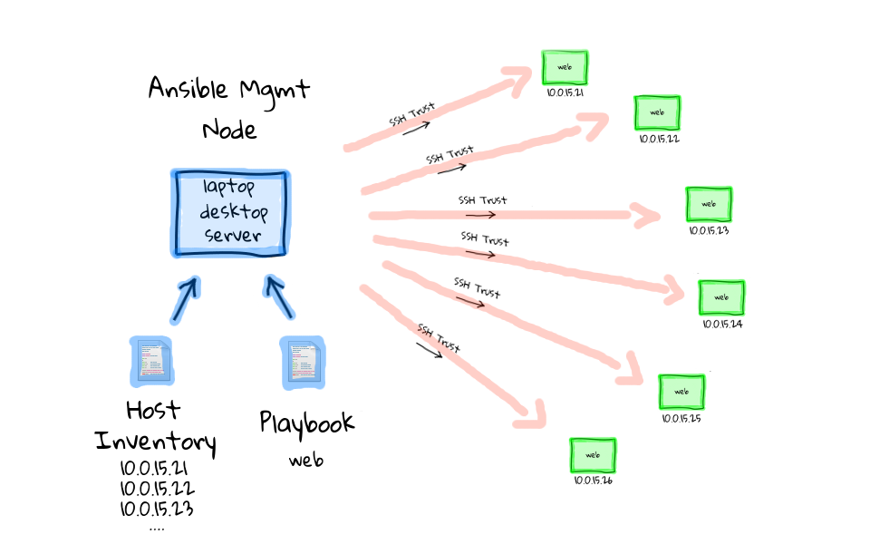
How ANSIBLE Works – at scale

Slide 22
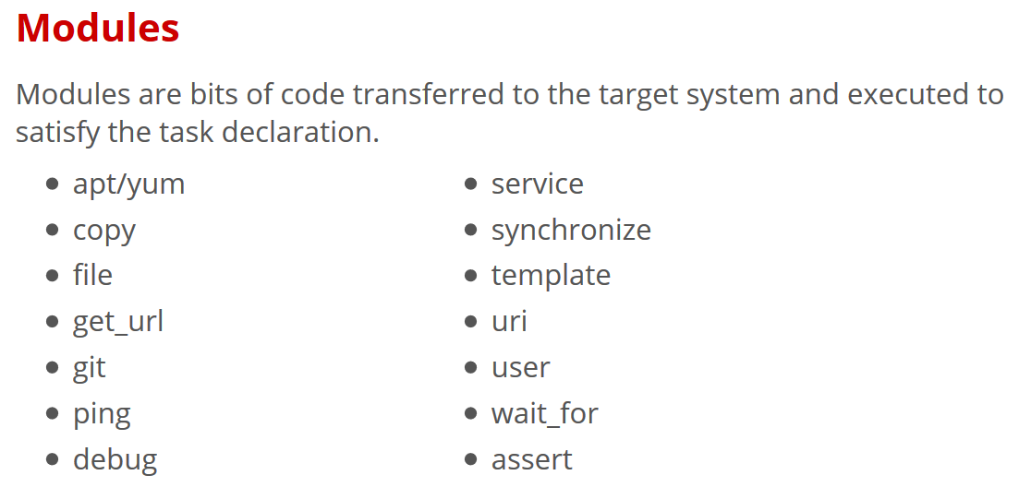

Slide 23
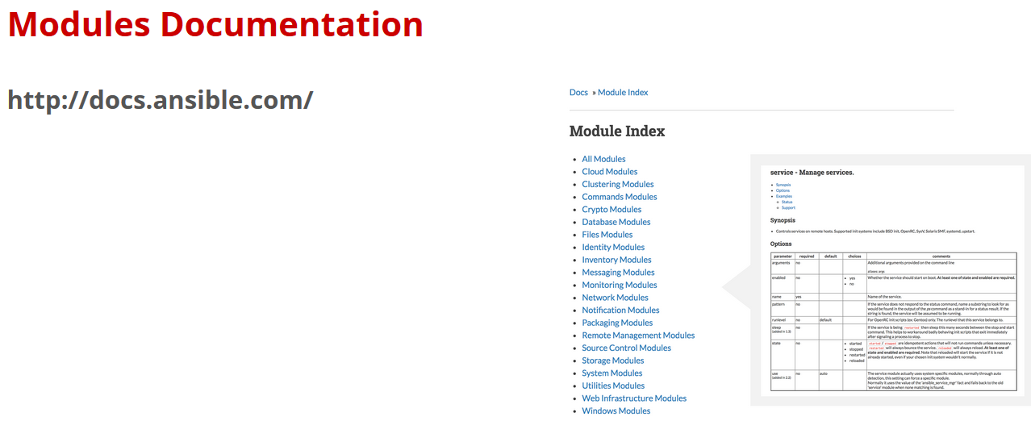

Slide 24
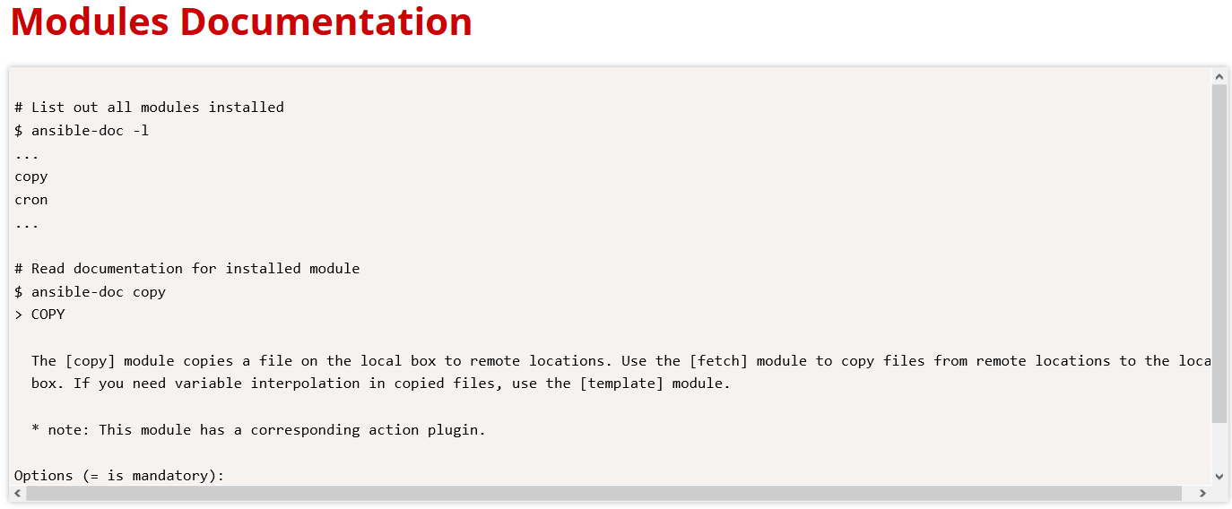

Slide 25
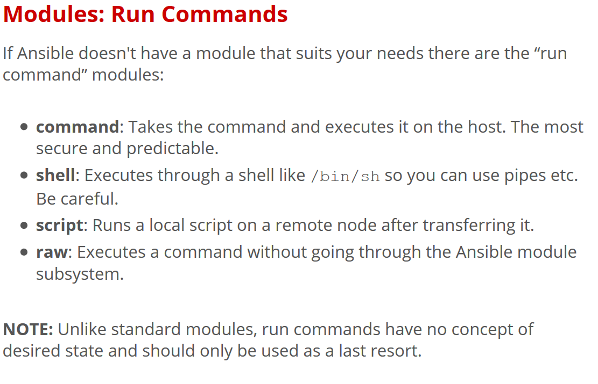

Slide 26
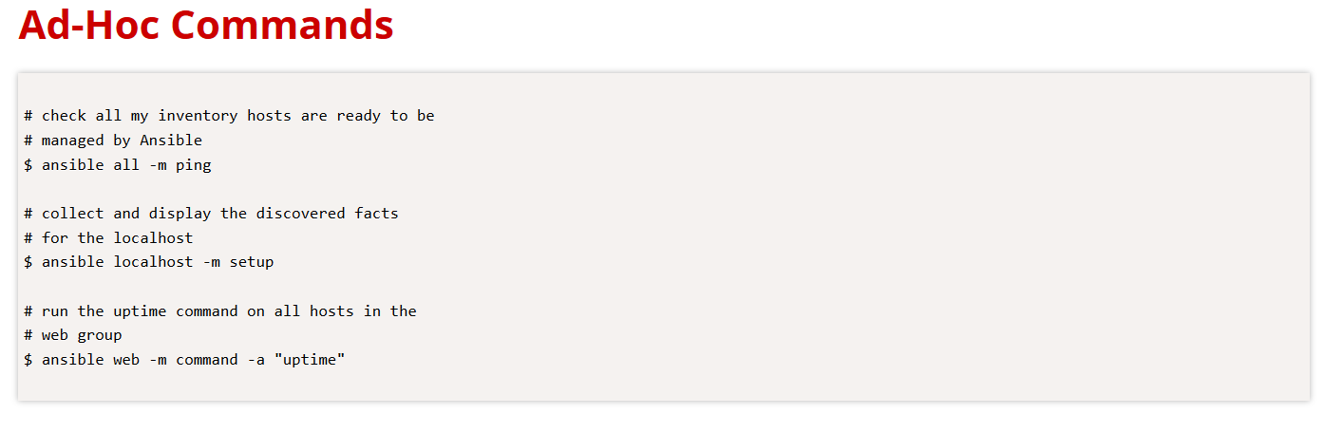

Slide 27
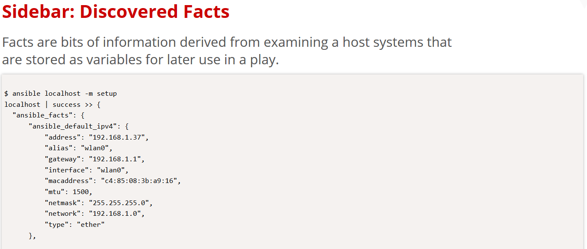

Slide 28
Lab 2 :Adhoc_Commands

Slide 29
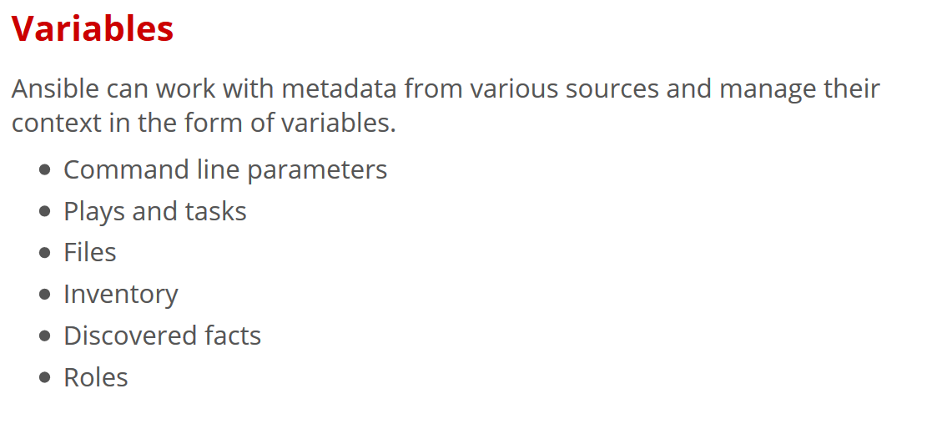

Slide 30
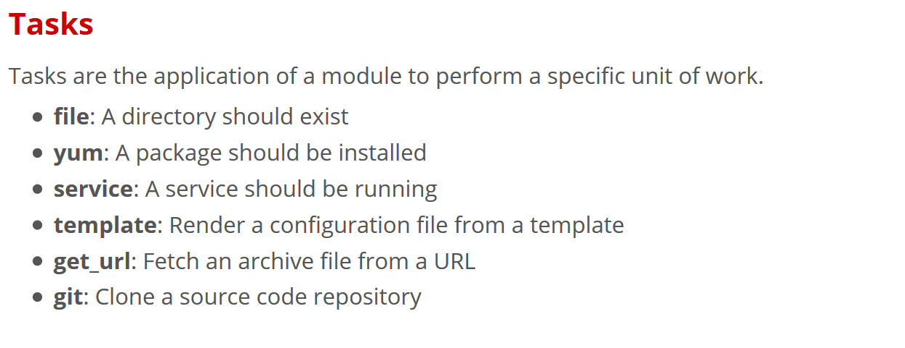

Slide 31
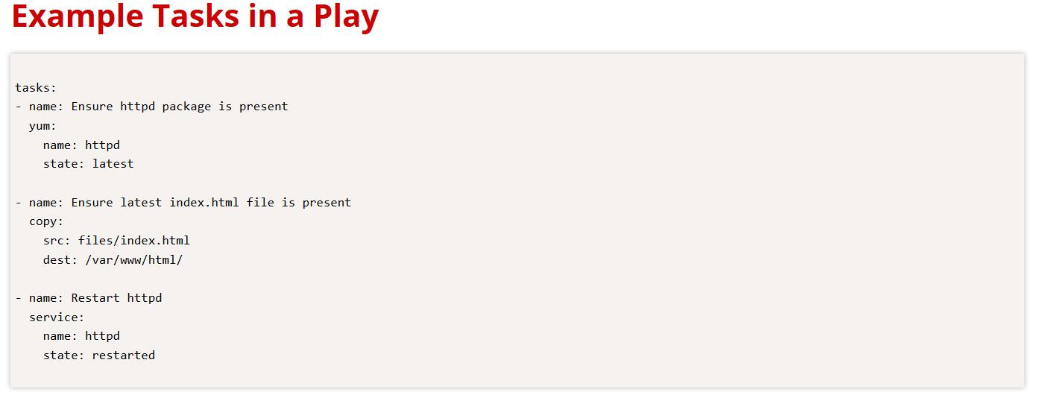

Slide 32
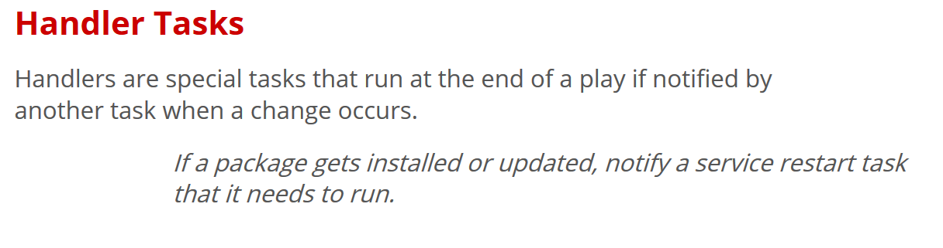

Slide 33
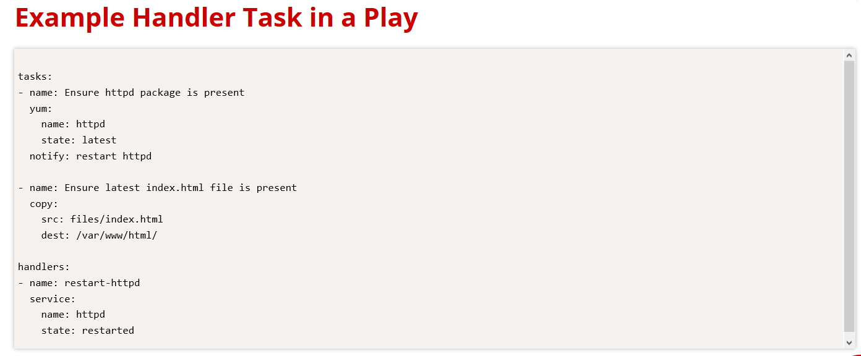

Slide 34
Lab 3 : Simple_Playbook (nginx)

Slide 35
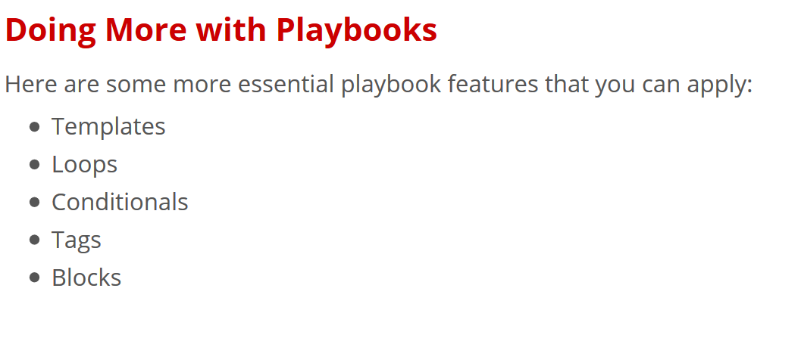

Slide 36
Lab 4 : Basic_Playbook (a more practical playbook)

Slide 37
Roles
Roles are a packages of closely related Ansible content that can be shared more easily than plays alone.
Improves readability and maintainability of complex plays
Eases sharing, reuse and standardization of automation processes
Enables Ansible content to exist independently of playbooks, projects -- even organizations
Provides functional conveniences such as file path resolution and default values

Slide 38
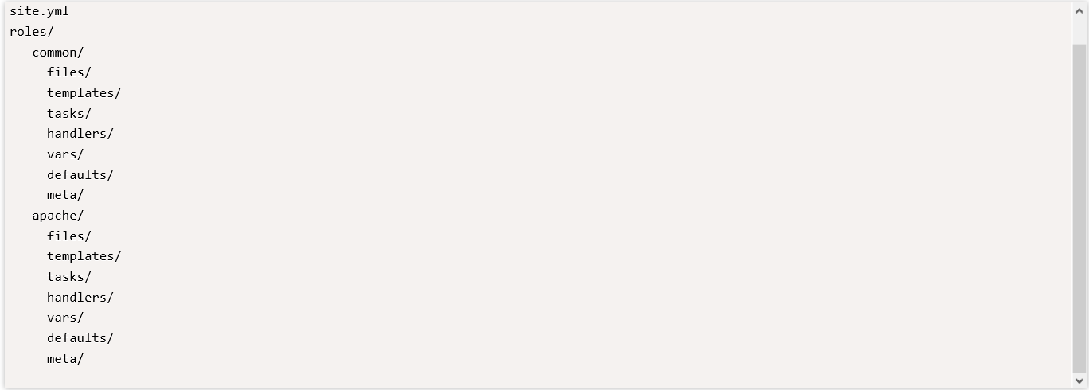
Project with Embedded Roles Example

Slide 39
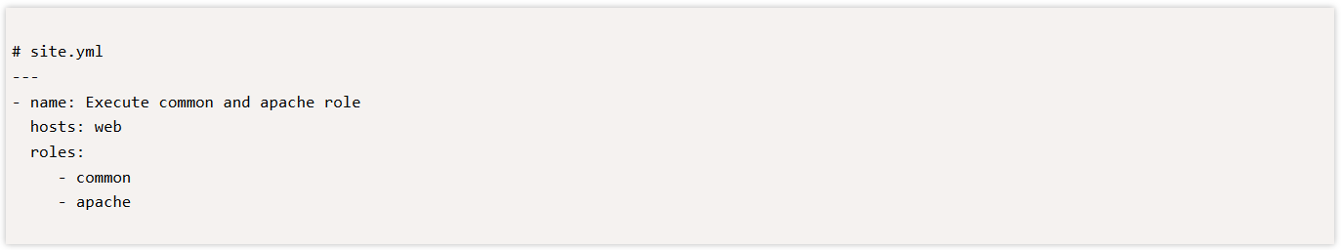
Project with Embedded Roles Example

Slide 40
Lab 5 : Roles

Slide 41
Next Steps
It's easy to get started ansible.com/get-started
Join the Ansible community ansible.com/community
Would you like to learn a lot more? redhat.com/en/services/training/do407-automation-ansible

Slide 42
Introduction to Ansible Tower

Slide 43
What You Will Learn
Red Hat® Ansible® Tower helps you scale IT automation, manage complex deployments and speed productivity. Centralize and control your IT infrastructure with a visual dashboard, role-based access control, job scheduling and graphical inventory management.
What is Ansible Tower
How Ansible Tower Works
Installing Ansible Tower
Key Features

Slide 44
What is Ansible Tower?
Ansible Tower is an enterprise framework for controlling, securing and managing your Ansible automation – with a UI and RESTful API
Role-based access control keeps environments secure, and teams efficient
Non-privileged users can safely deploy entire applications with push-button deployment access
All Ansible automations are centrally logged, ensuring complete auditability and compliance

Slide 45
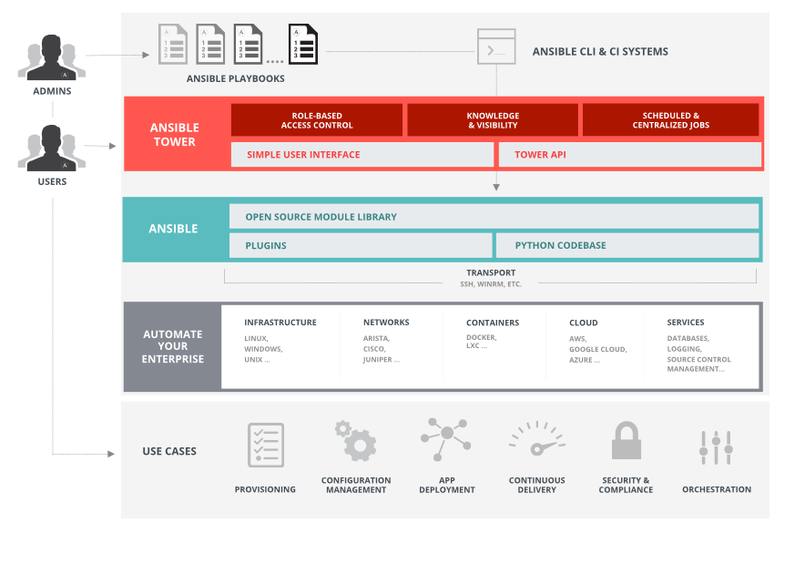
Platform Overview

Slide 46
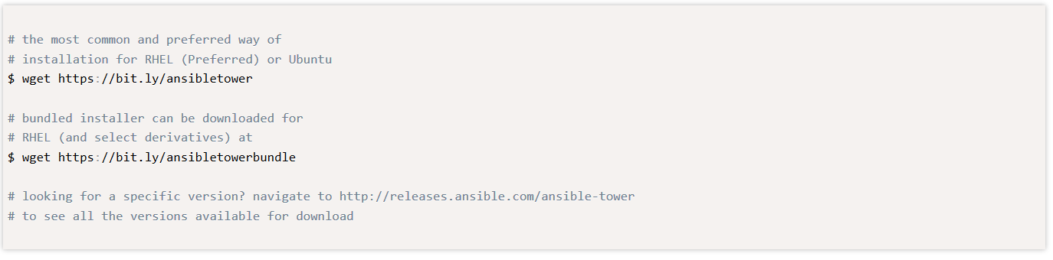
Installing Ansible Tower

Slide 47
Server Requirements
Red Hat Enterprise Linux (RHEL) 7 (and select derivatives), Ubuntu 14.04 64-bit, and Ubuntu 16.04 LTS 64-bit support required (kernel and runtime).
A currently supported version of Mozilla Firefox or Google Chrome.
2 GB RAM minimum (4+ GB RAM highly recommended)
20 GB of dedicated hard disk space

Slide 48
Lab : Installing Ansible Tower

Slide 49
Key Features of Ansible Tower
Dashboard and User Interface
User Base -- Organizations, Teams & Users
Credentials
Inventories
Projects
Job Templates & Jobs
Role Based Access Control (RBAC)

Slide 50
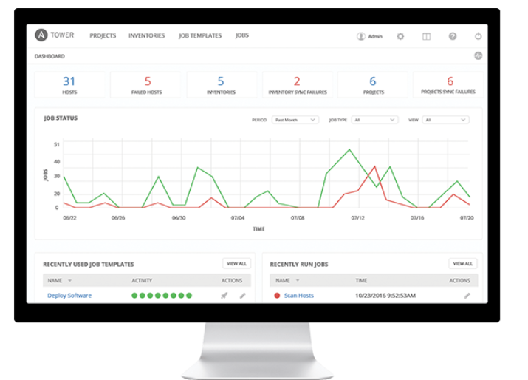
Dashboard and User Interface

Slide 51
User Base
A user is an account to access Ansible Tower and its services given the permissions granted to it.
An organization is a logical collection of users, teams, projects, inventories and more. All entities belong to an organization with the exception of users.
Teams provide a means to implement role-based access control schemes and delegate responsibilities across organizations.

Slide 52
Credentials
Credentials are utilized by Ansible Tower for authentication with various external resources:
Connecting to remote machines to run jobs
Syncing with inventory sources
Importing project content from version control systems
Connecting to and managing networking devices
Centralized management of various credentials allows end users to leverage a secret without ever exposing that secret to them.

Slide 53
Inventory
Inventory is a collection of hosts (nodes) with associated data and groupings that Ansible Tower can connect to and manage.
Hosts (nodes)
Groups
Inventory-specific data (variables)
Static or dynamic sources

Slide 54
Projects
A Project is a logical collection of Ansible Playbooks, represented in Ansible Tower.
You can manage Playbooks and Playbook directories by placing them in a source code management system supported by Ansible Tower, including Git, Subversion, and Mercurial.

Slide 55
Job Templates
A job template is a definition and set of parameters for running an Ansible Playbook. Job templates are useful to execute the same job many times and encourage the reuse of Ansible Playbook content and collaboration between teams.

Slide 56
Jobs
A job is an instance of Ansible Tower launching an Ansible Playbook against an inventory of hosts.
Job results can be easily viewed
View the standard out for a more in-depth look

Slide 57
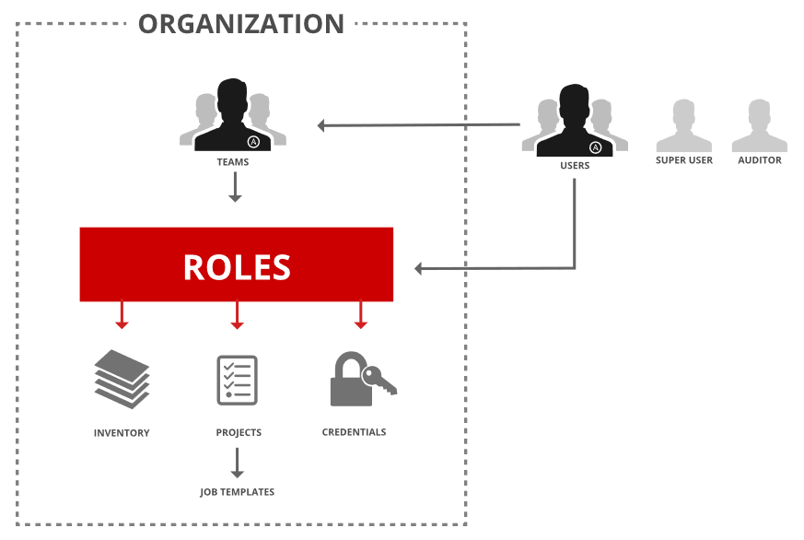
Role Based Access Control (RBAC)
Role-Based Access Controls (RBAC) are built into Ansible Tower and allow administrators to delegate access to server inventories, organizations, and more. These controls allow Ansible Tower to help you increase security and streamline management of your Ansible automation.

Slide 58
Lab : Configuring Ansible Tower

Slide 59
Dynamic Inventory in Ansible Tower
Dynamic inventory is a script that queries a service, like a cloud provider API or a management application. This data is formatted in an Ansible-specific JSON data structure and is used in lieu of static inventory files.
Groups are generated based on host metadata
Single source of truth saves time, avoids duplication and reduces human error
Dynamic and static inventory sources can be used together

Slide 60
More with Ansible Tower
Job Status Updates
Activity Stream
Integrated Notifications
Schedule Jobs
Manage and Track Your Inventory
Self Service IT (User Surveys)
Remote Command Execution
External Logging
Multi-Playbook Workflows

Slide 61
Next Steps
It’s easy to get started ansible.com/get-started
Try Ansible Tower for free: ansible.com/tower-trial
Would you like to learn a lot more? redhat.com/en/services/training/do409-automation-ansible-ii-ansible-tower

Slide 62
Lab : Creating and Running
Job Template

Slide 63
THANK YOU
plus.google.com/+RedHat
facebook.com/redhatinc
linkedin.com/company/red-hat
twitter.com/RedHatNews
youtube.com/user/RedHatVideos

Slide 64
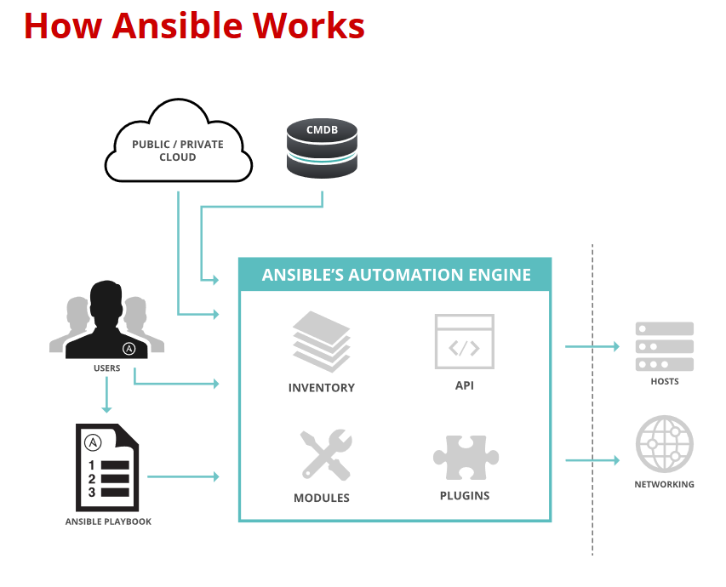

Slide 65
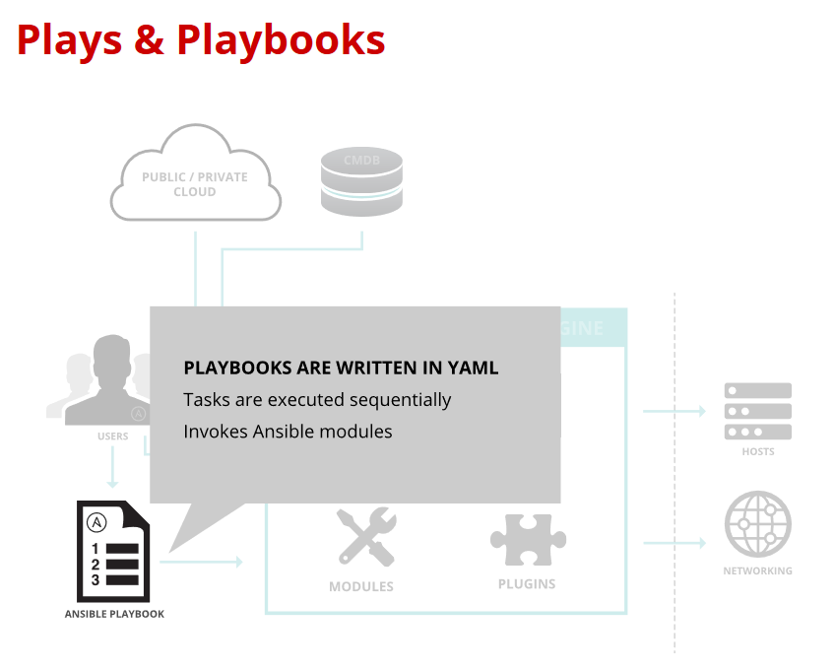

Slide 66
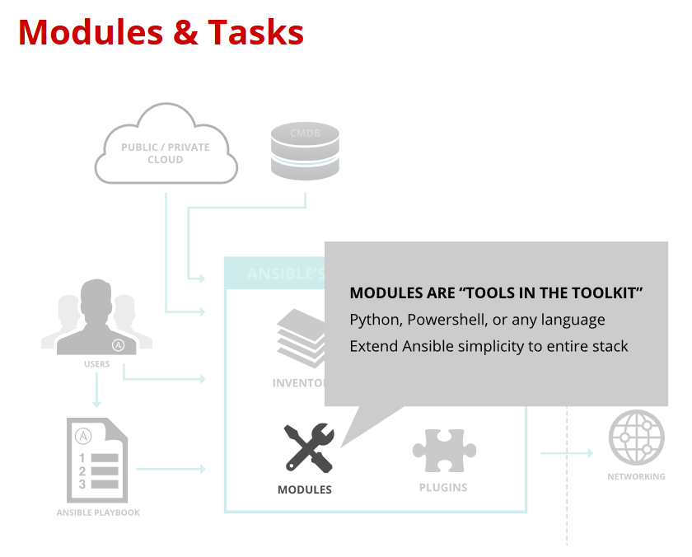

Slide 67
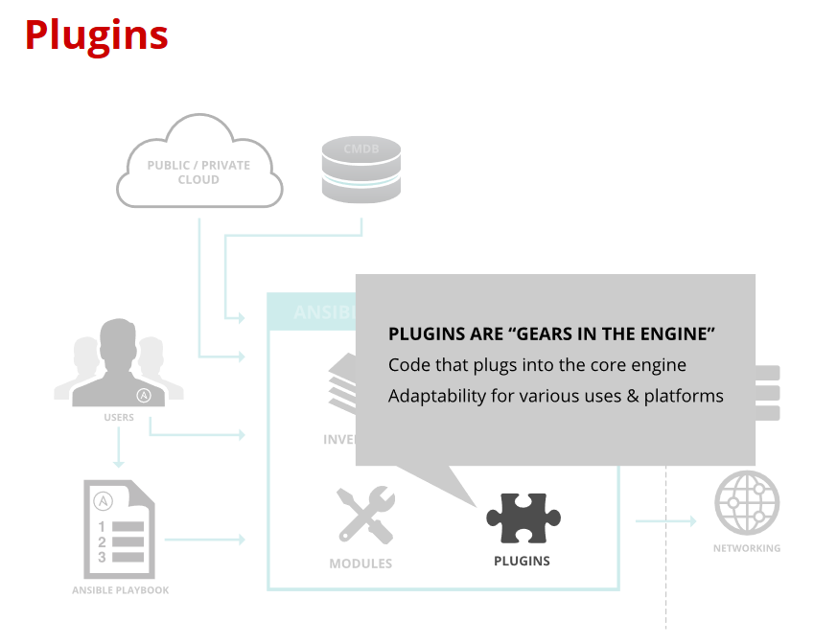

Slide 68
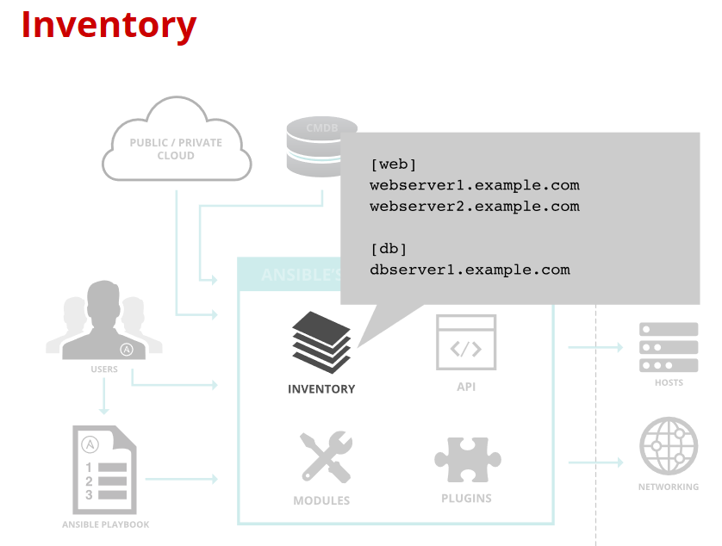

Slide 69
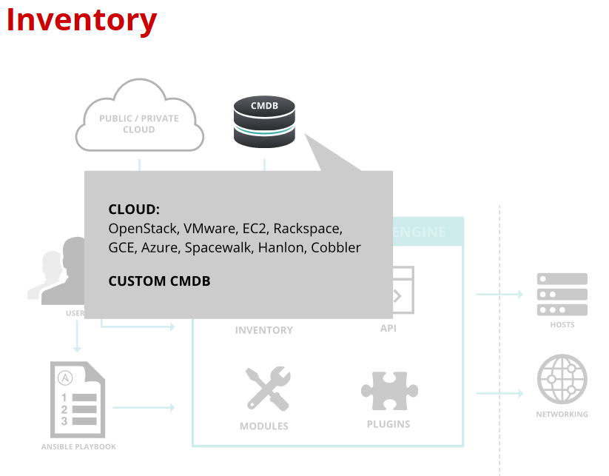

Slide 70
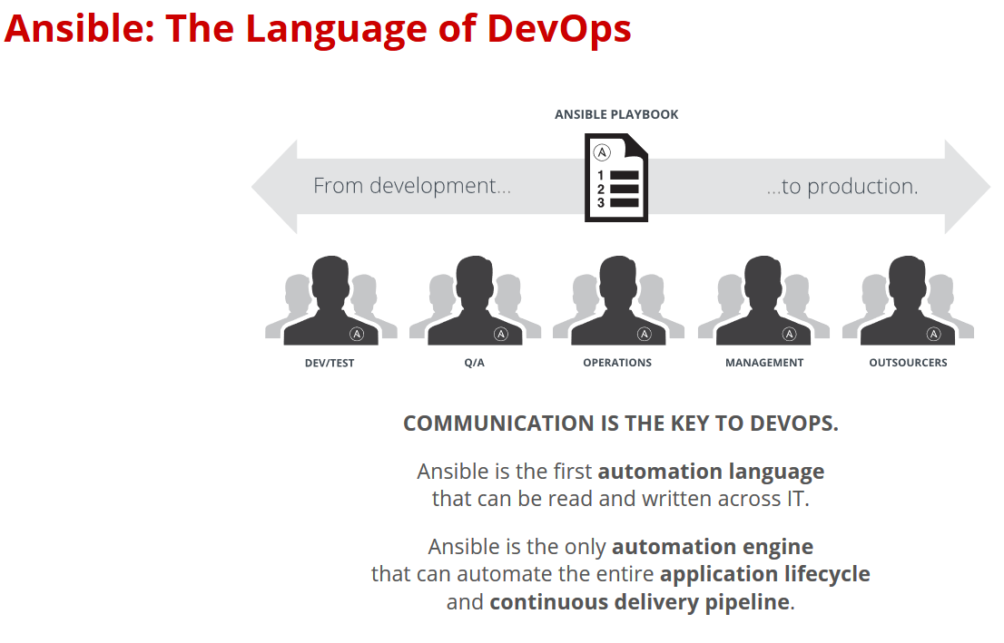

Slide 71
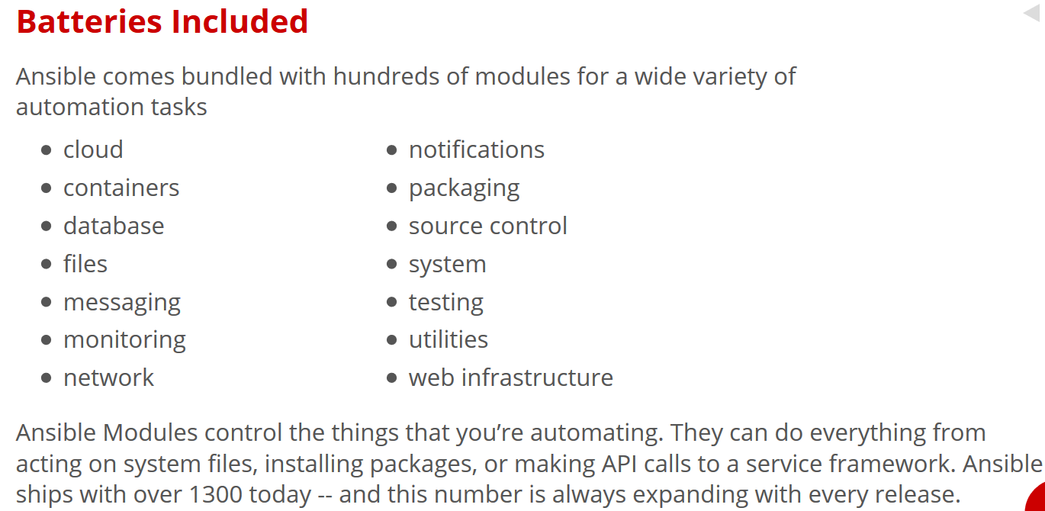

Slide 72
